Slide 1
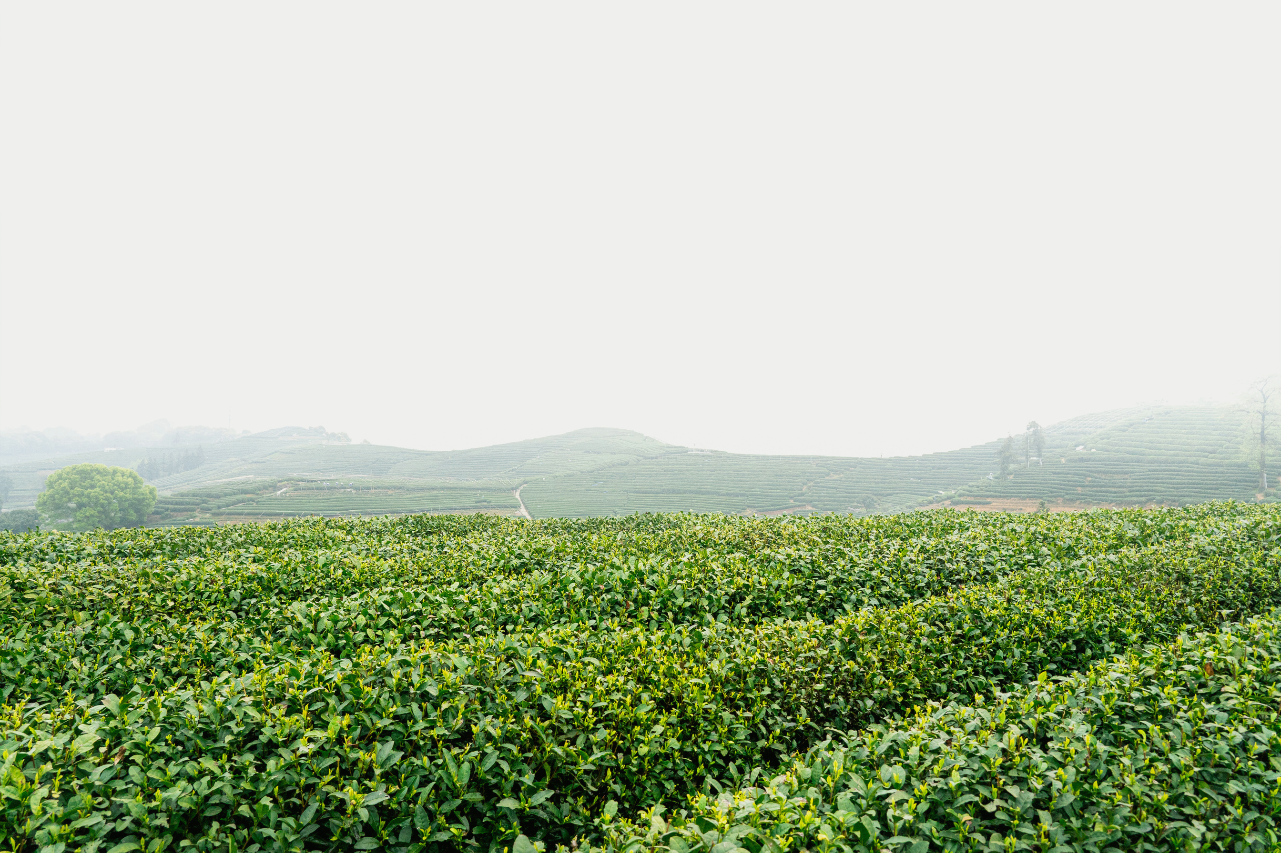


P08
AgriQual

Slide 2
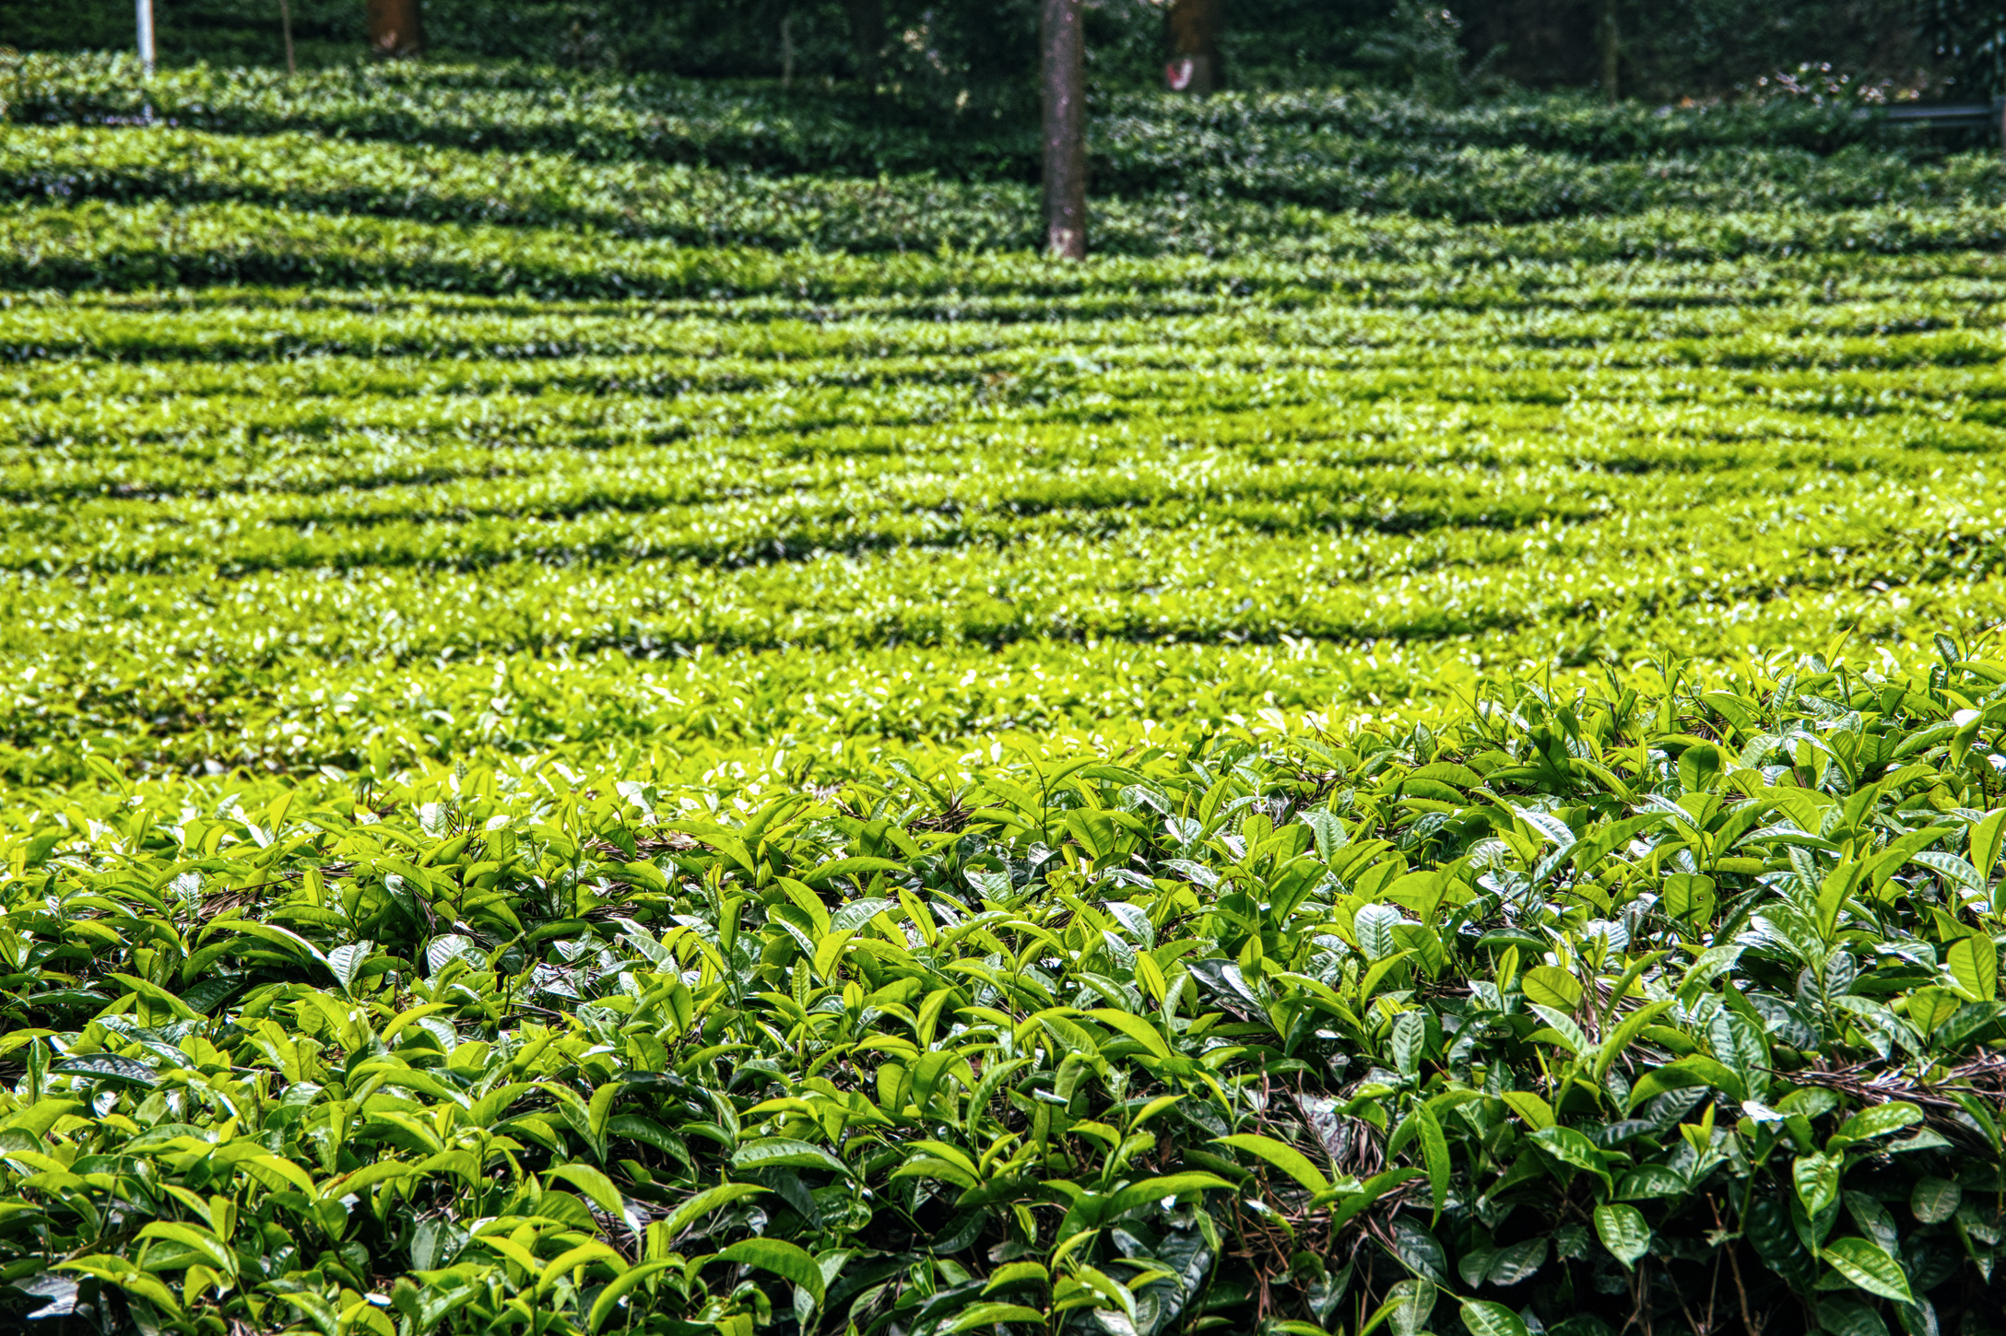
What is the overall project idea?
The project is an innovative AI driven system designed to support farmers by providing personalized agricultural advice. This project will incorporate a multi-agent system where specialized AI agents work together to provide comprehensive solutions. These agents include vision, climate and advisory agents that can provide real-time recommendations to farmers.

Slide 3
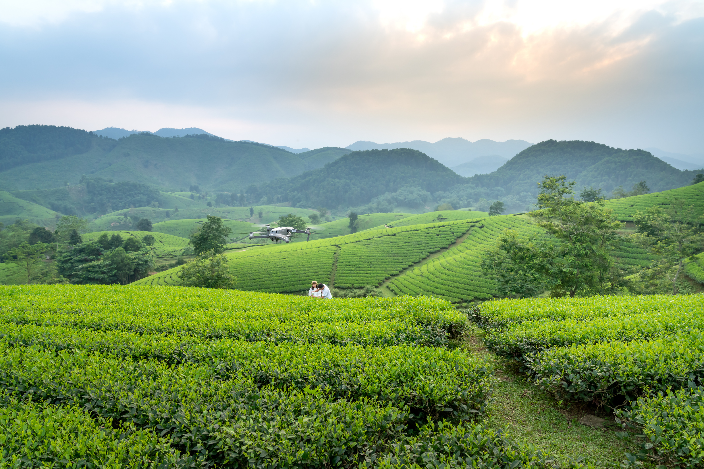
Farmers will receive actionable farming advice via crop diagnosis by uploading images and weather forecasts linked to an advisory agent
01
The system should be highly available and responsive by processing images within 15 seconds and be able to handle higher number of uploads
02
What are the major requirements?
Quality inspectors will be able to validate crop quality and compliance by using the system to assess harvested crops, ensuring they meet market standards
03

Slide 4
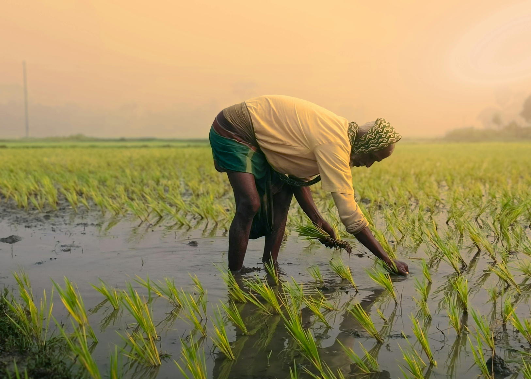
Our Target
Users
Farmers: Get instant expert advice on crop problems and smart recommendations for watering and fertilization while preventing crop losses by catching diseases and pest issues before they spread across fields
Quality inspectors: Use intelligent advisory system to check crop quality faster and meet export standards without manual guesswork. This allows inspectors to focus on difficult cases while the system provides guidance for routine batch inspections
01
02

Slide 5


Possible Extensions
Post SProj
Integrate agents to provide real time crop price trends, demand forecasts and market recommentions to help farmers maximize profit.
Addition of multi-language support and voice based interfaces to reach farmers with limited literacy, making agricultural expertise accessible across diverse rural communities.
Connect farmers with logistics providers, buyers and exporters enabling smooth farm to market operations
01
01
02
03

